Slide 1
Linking ArchivesSpace Hierarchy to DSpace Digital Objects
Terry Brady and Suzanne Chase
Georgetown University Library
http://bit.ly/as2dspace

Slide 2
Background
DigitalGeorgetown is our repository that hosts both institutional scholarship and digitized special collections materials; currently runs on DSpace version 6.3
We migrated to ArchivesSpace from Archivist’s Toolkit and adopted the PUI in 2016; we updated to ArchivesSpace version 2.x in August 2017
We developed a workflow in Fall 2018 that harvests EAD metadata from ArchivesSpace and converts it to Dublin Core metadata for digitized archival materials hosted in our DSpace repository. We then create digital object records in ArchivesSpace that link back to the digital surrogates of items in DSpace. This workflow expedites the process of creating digital object records, which in the ArchivesSpace data model are linked to archival object records as instances.

Slide 3
Patron needs
ArchivesSpace presents a hierarchical navigation and view of archival collections
DSpace presents digital images of individual items within an archival collection
Patrons need to be able to browse the hierarchy of an archival collection in ArchivesSpace and be provided with links to view individual digital objects and their associated item-level metadata (when available) in our DSpace repository.
This workflow enables that process and creates bidirectional links between the ArchivesSpace public user interface and the DSpace repository interface.

Slide 4
Workflow tools
File Analyzer (open source program developed by Georgetown’s Library IT Department) for converting ArchivesSpace EAD XML metadata into Dublin Core
Excel and Google sheets for editing and adding to item-level Dublin Core metadata
DSpace ingest tools for batch uploading digital objects and their metadata
DSpace report tools for exporting digital object and thumbnail URLs
Harvard’s Excel Import Plugin for creating digital object records in ArchivesSpace
*All links and documentation for this workflow are available at http://bit.ly/as2dspace

Slide 5
Workflow Demo
In the following slides, we will quickly go through each step of the following workflow diagram

Slide 6
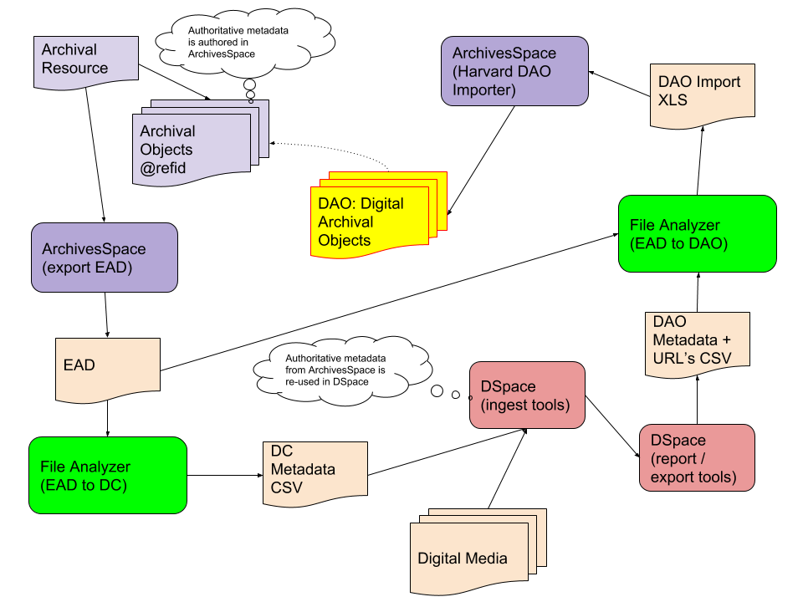

Slide 7
Export EAD for an ArchivesSpace Collection Record

Slide 9
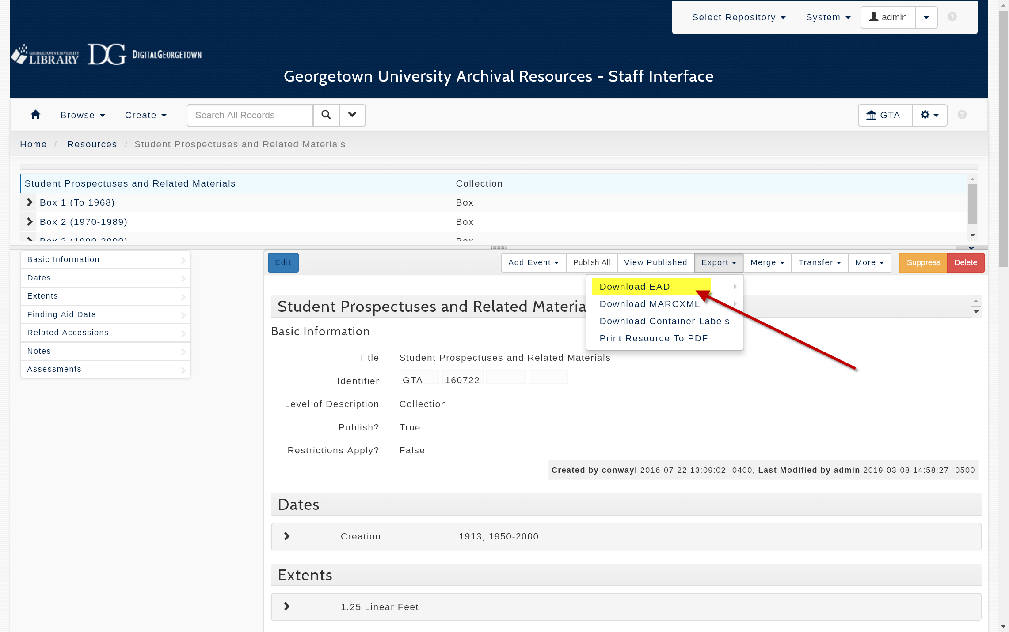

Slide 10
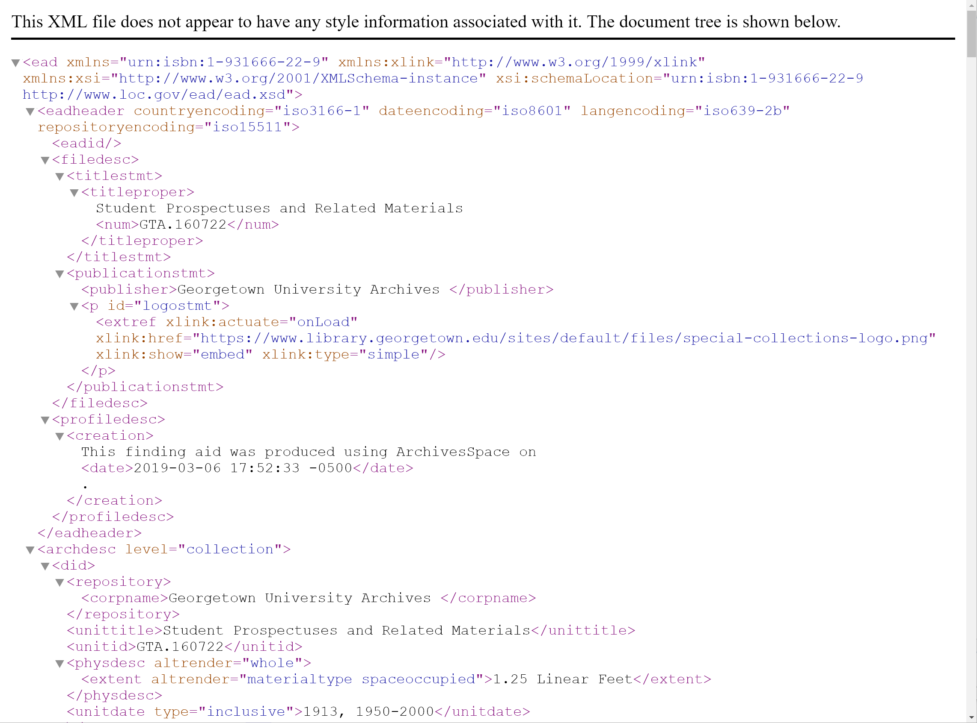

Slide 11
2. Convert EAD to Dublin Core

Slide 13
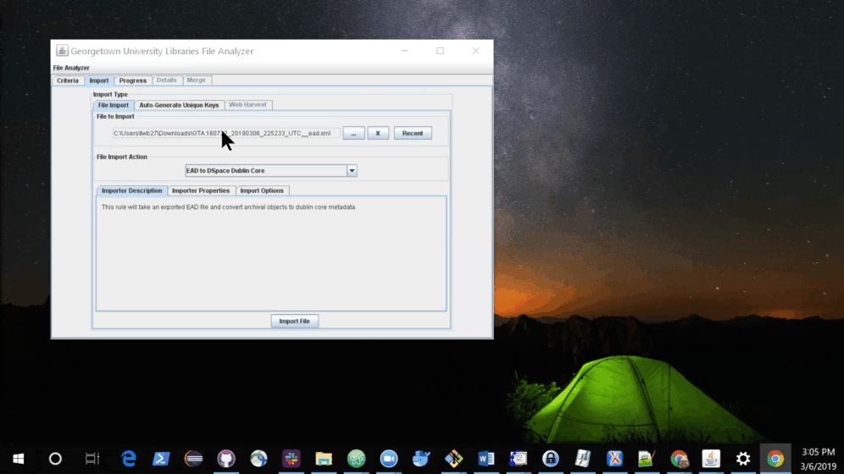

Slide 14
3. Edit Dublin Core to Contextualize for the Digital Collection

Slide 16
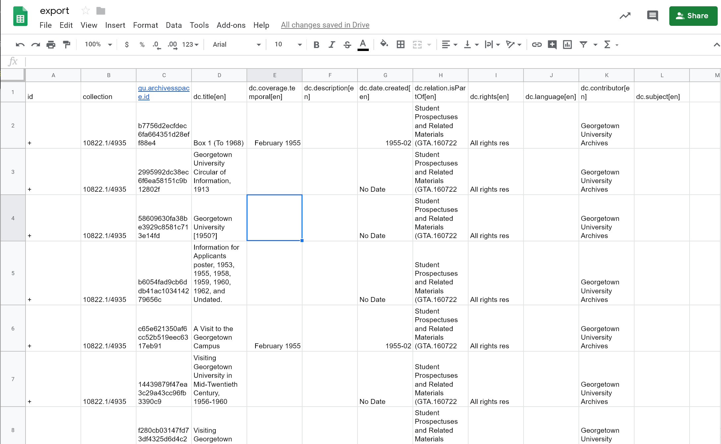

Slide 17
4. Prepare Ingest Folders for DSpace
Bitstream files are associated with metadata and are imported into DSpace

Slide 19
Simple Archive Format Ingest
Item Metadata
(CSV)
DSpace
Digital Files
(bitstreams)

Slide 20
5. View Bitstreams (Digital Objects) in DSpace

Slide 22
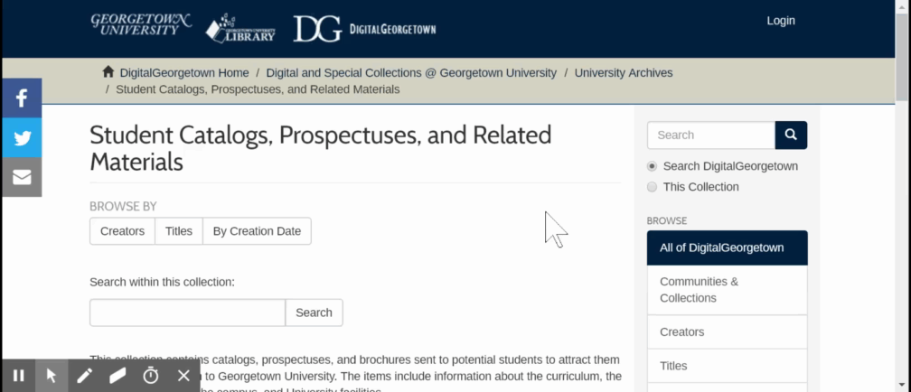

Slide 23
6. Export Item Metadata with Bitstream URL’s

Slide 25
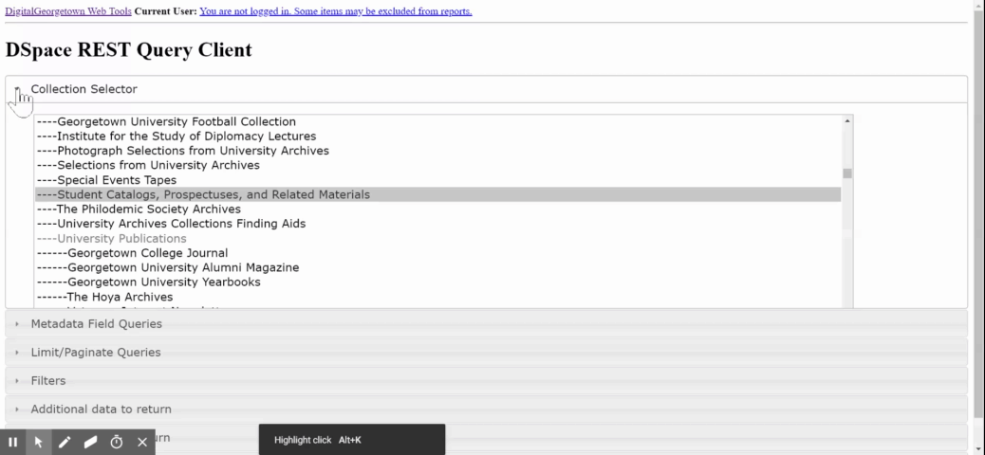

Slide 26
7. Merge report data with EAD file to generate an Excel import file
The merge can be performed on AS refid (if available) or on Title

Slide 28
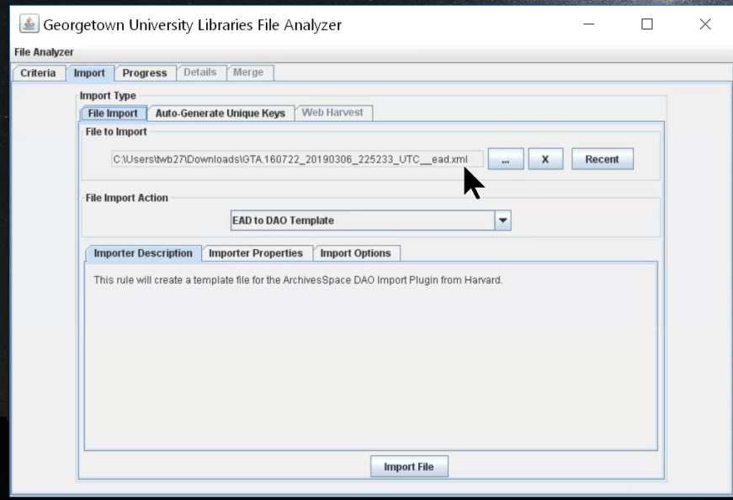

Slide 29
8. Review the generated Excel file

Slide 31
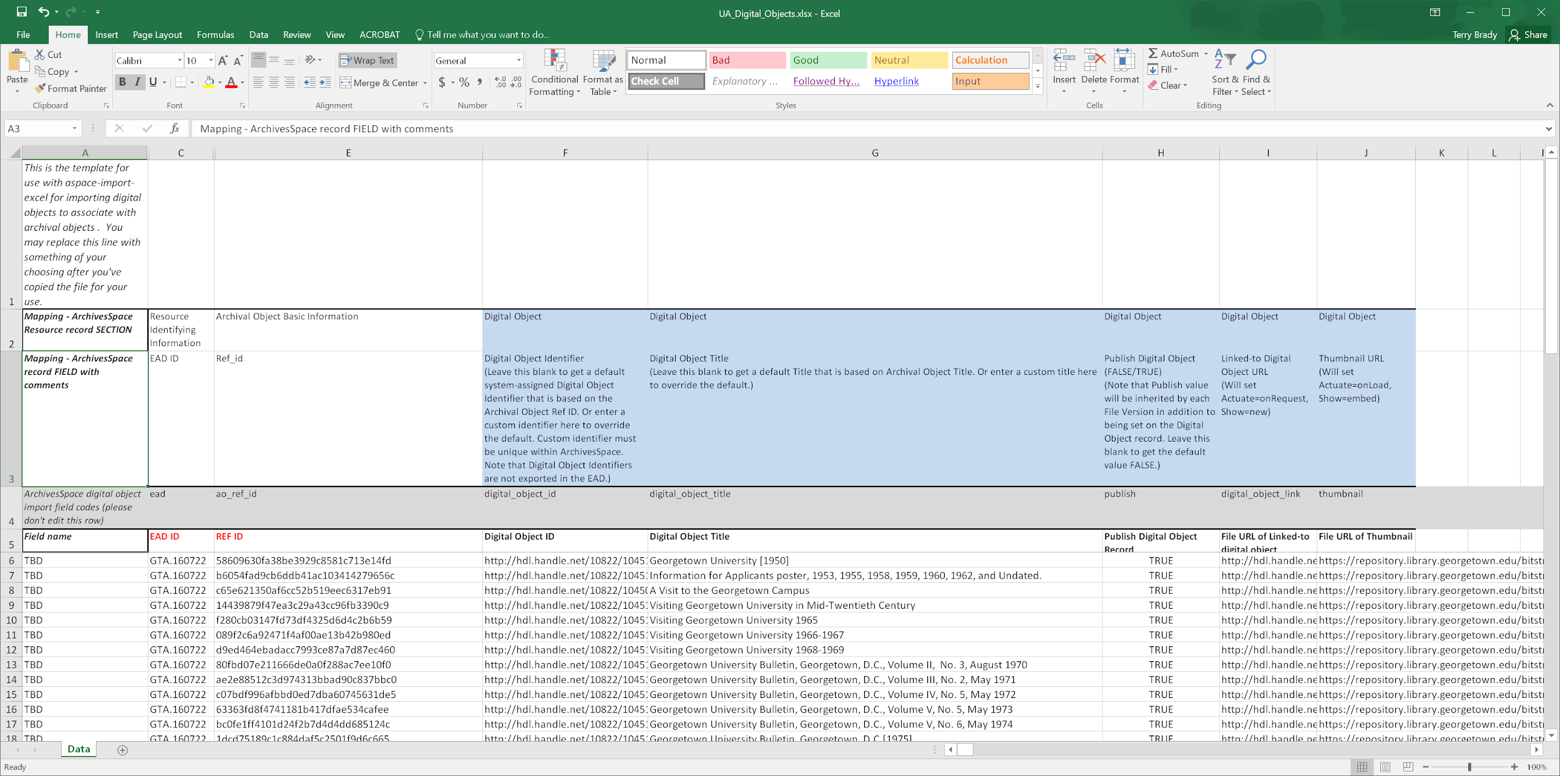

Slide 32
9. Import the Excel file with the Harvard Plugin

Slide 34
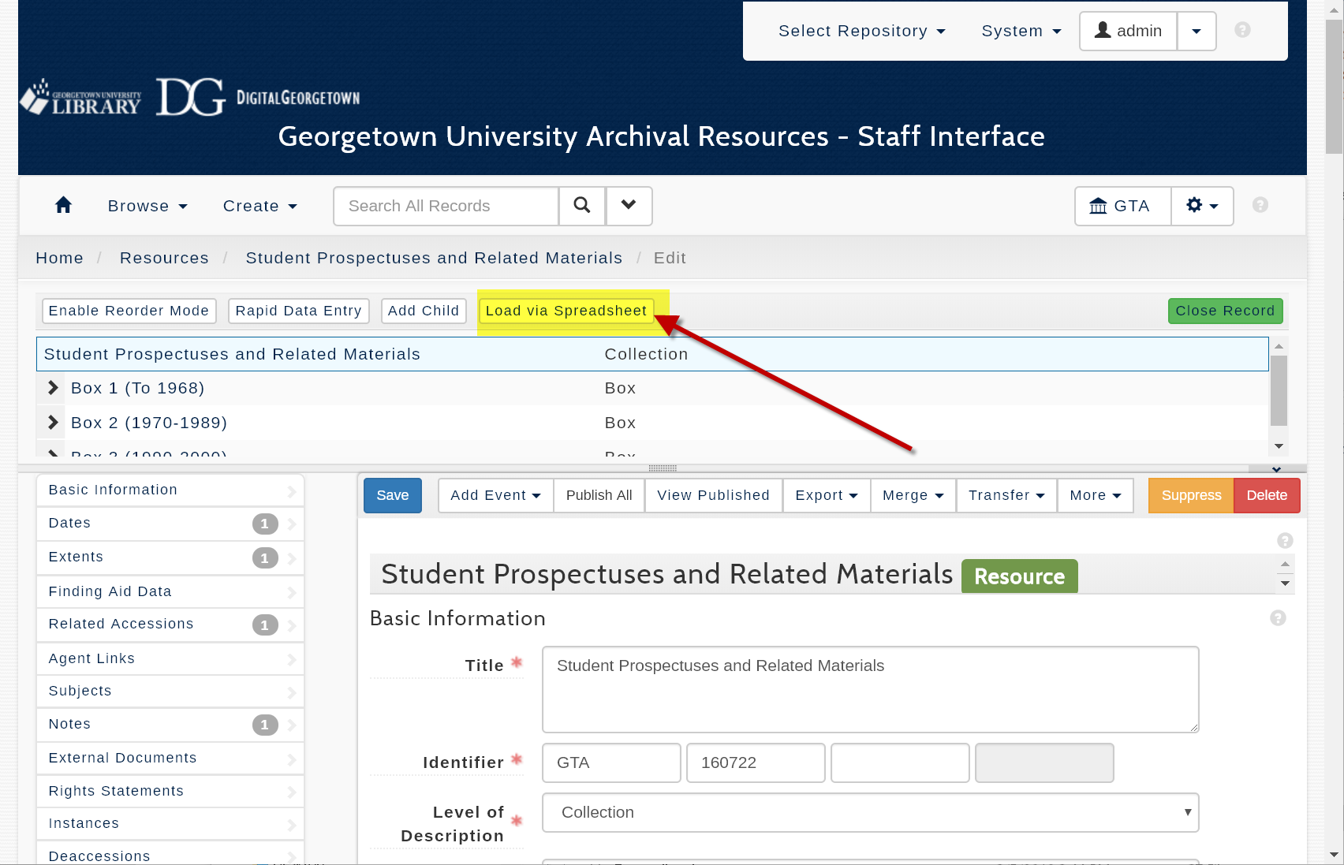

Slide 35
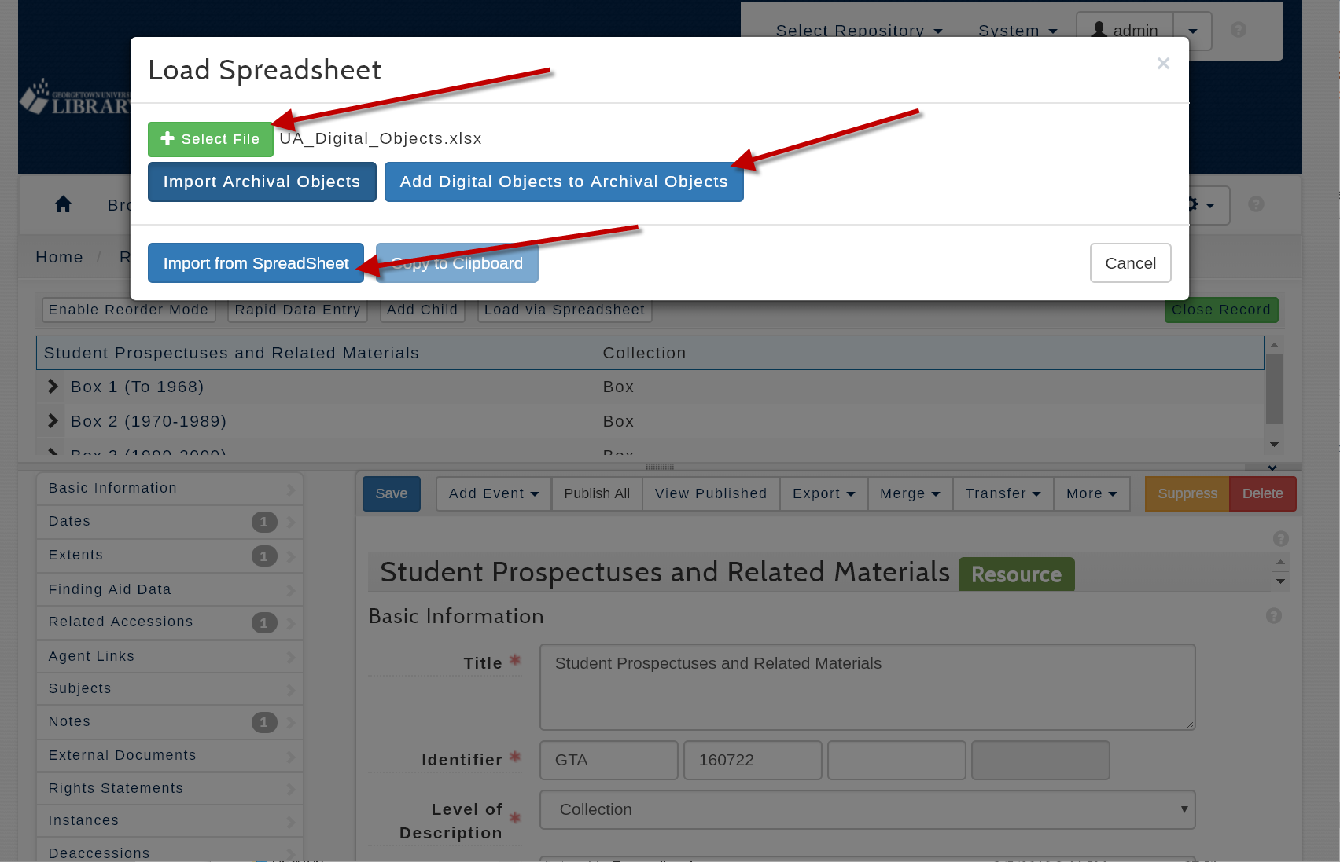

Slide 36
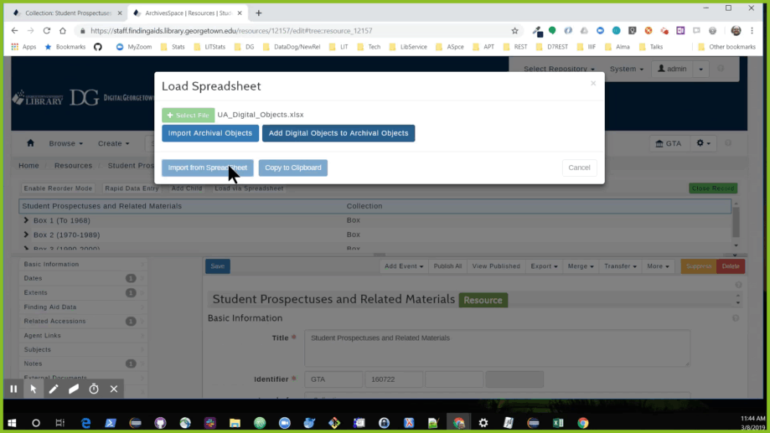

Slide 37
10. View the Digital Objects in the ArchivesSpace PUI

Slide 39
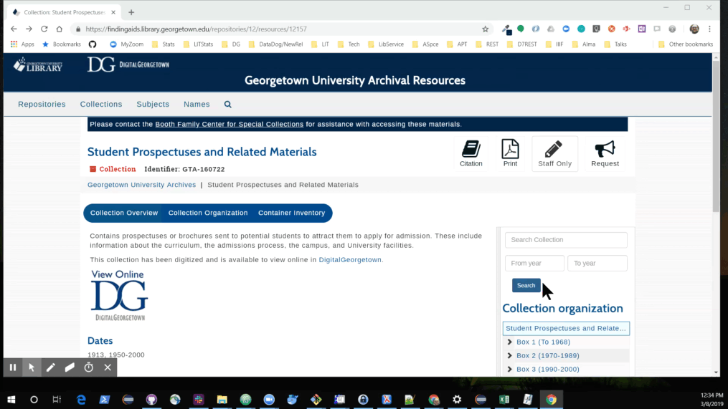

Slide 40
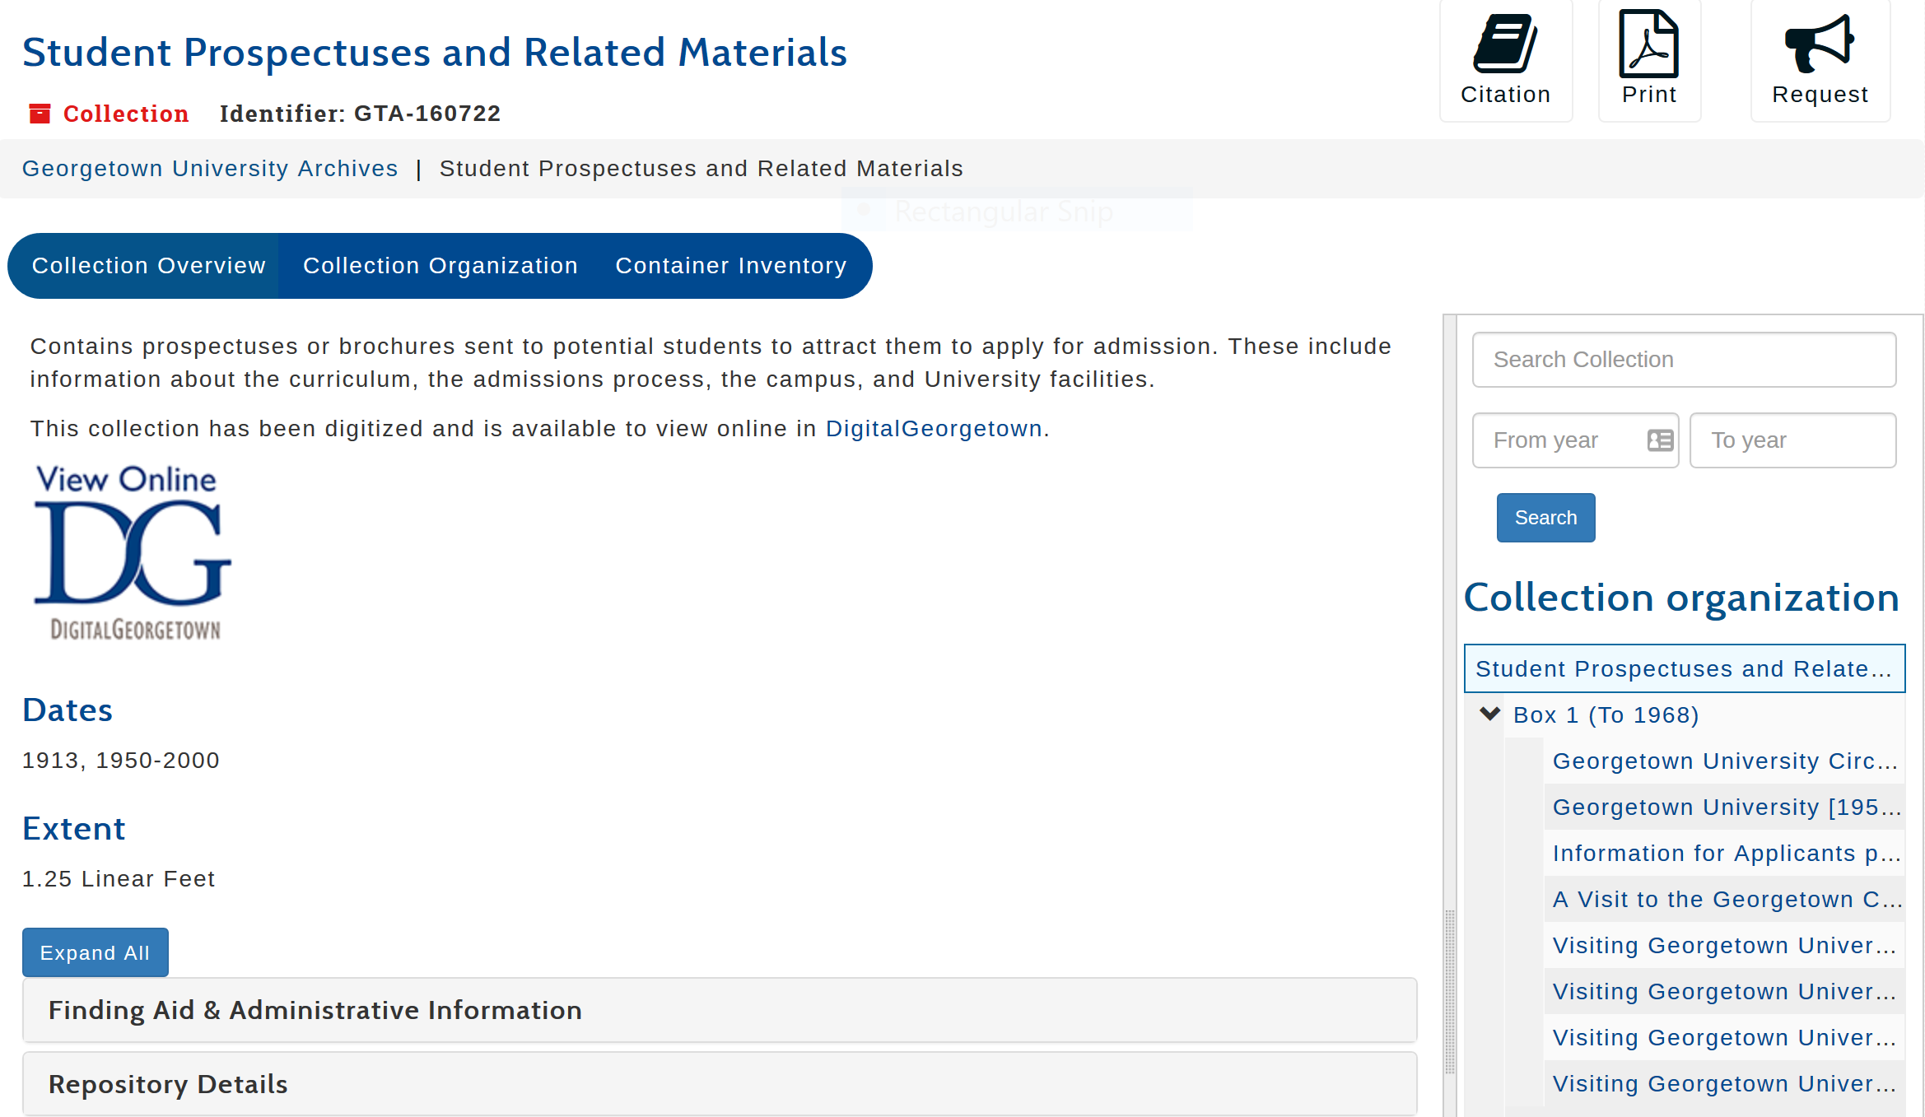

Slide 41
Next steps
We have implemented this entire workflow for one digitized archival collection in production as a pilot project (the example we have demonstrated today).
We are actively continuing to refine our processes and tools as we roll this out for newly digitized archival collections that are described in ArchivesSpace.
We plan to revisit collections that have been digitized and available in our DSpace repository for a while, to add in the digital object links to the collections’ finding aids in ArchivesSpace.

Slide 42
More information
View this example archival collection in our ArchivesSpace user interface: https://findingaids.library.georgetown.edu/repositories/12/resources/12157
View this example digital collection in our DSpace repository: https://repository.library.georgetown.edu/handle/10822/1045094
GitHub documentation with links to the tools we have demonstrated: http://bit.ly/as2dspace
Contact us! digitalscholarship@georgetown.edu

