Slide 1

Linking ArchivesSpace Hierarchy to DSpace Digital Objects
Terry Brady
Georgetown University Library
https://github.com/terrywbrady/info
http://bit.ly/as2dspace

Slide 2
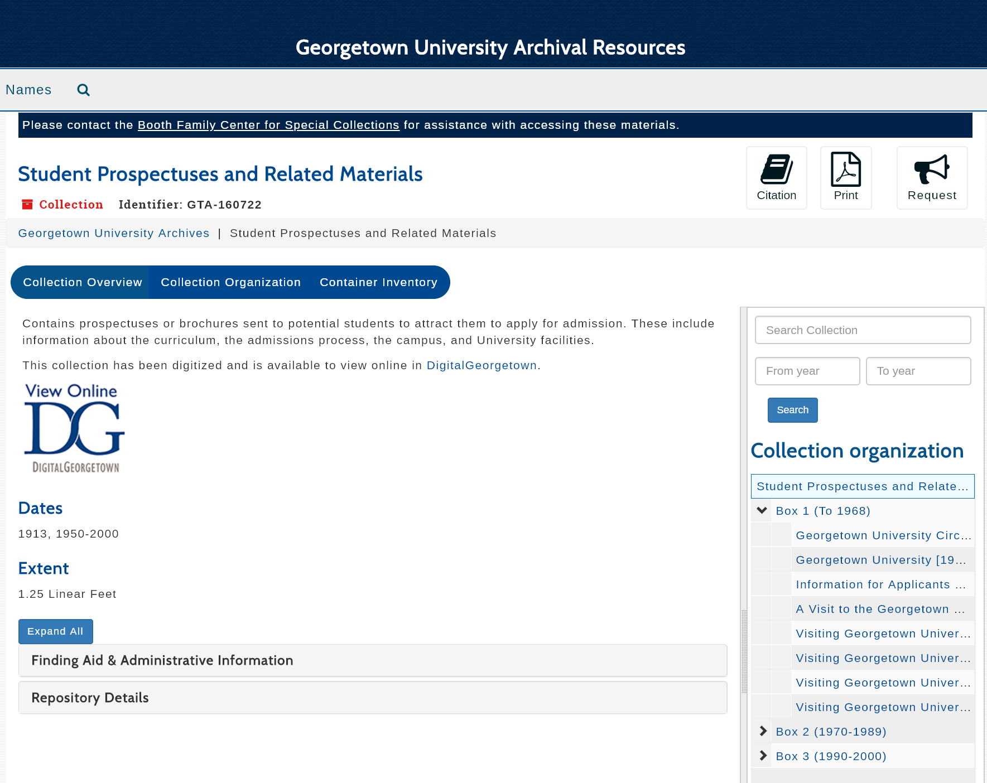
ArchivesSpace Collection - Student Prospectuses
Authoritative Metadata
Archival Navigation
ArchivesSpace does not host digital media
Archival Terminology

Slide 3
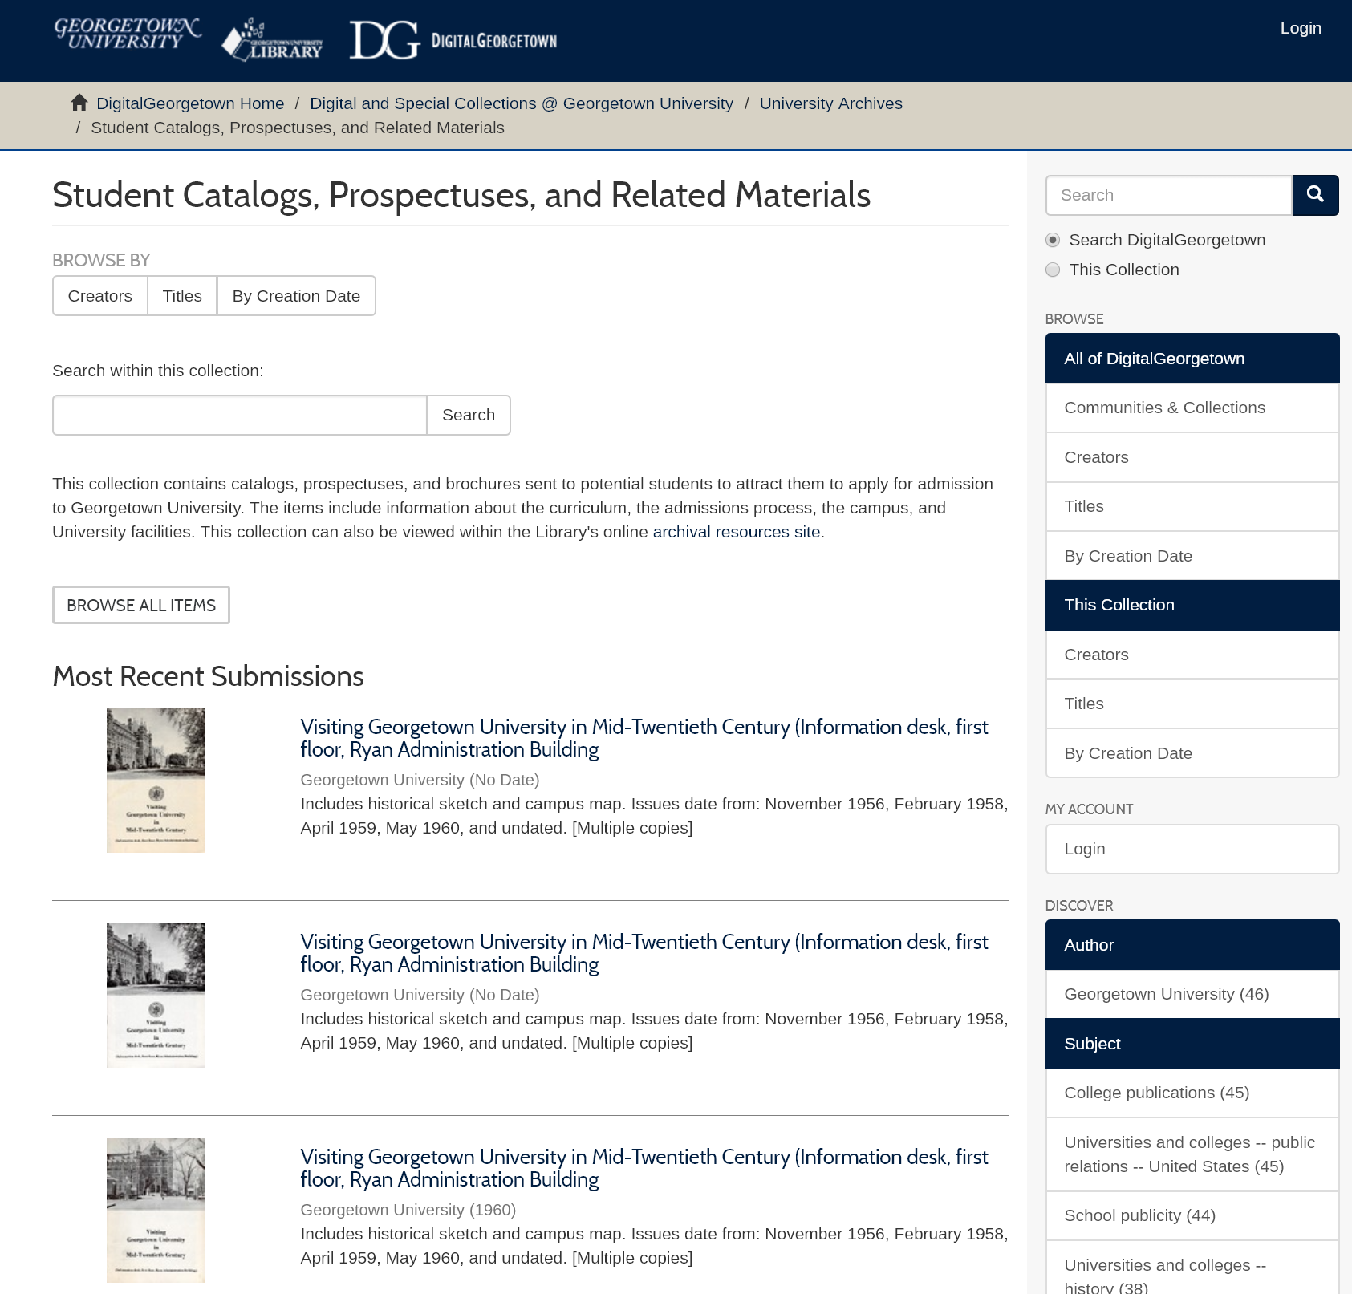
DSpace Collection - Student Prospectuses
DSpace does host digital media
Full-text search and faceted navigation

Slide 4
Export EAD for an ArchivesSpace Collection Record
Export authoritative metadata as EAD (Encoded Archival Description) XML for use in other systems

Slide 5
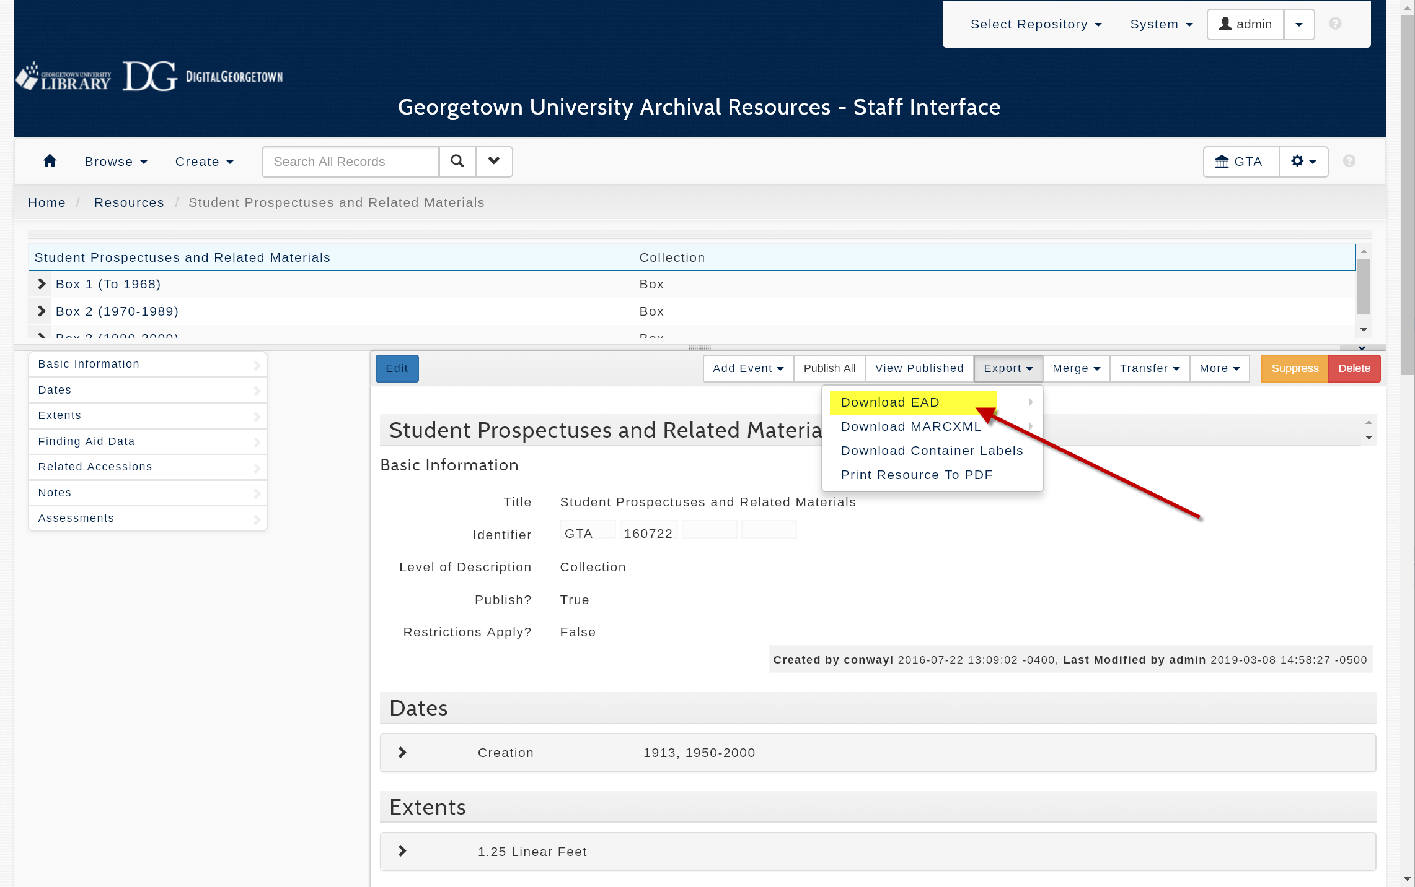

Slide 6
2. Convert EAD to Dublin Core
Flatten hierarchy to accompany a specific digital object

Slide 7
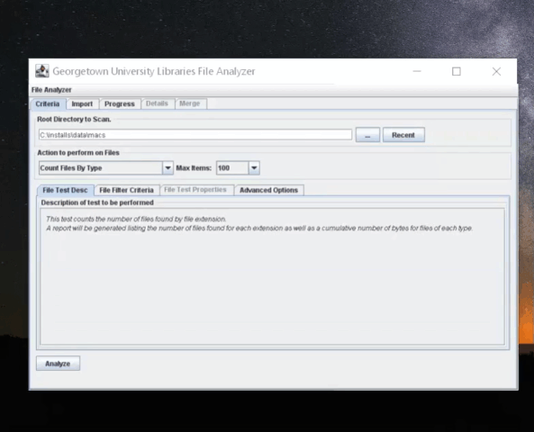

Slide 8
3. Edit Dublin Core to Contextualize for the Digital Collection
Users of the digital repository may not be familiar with archival terminology

Slide 9
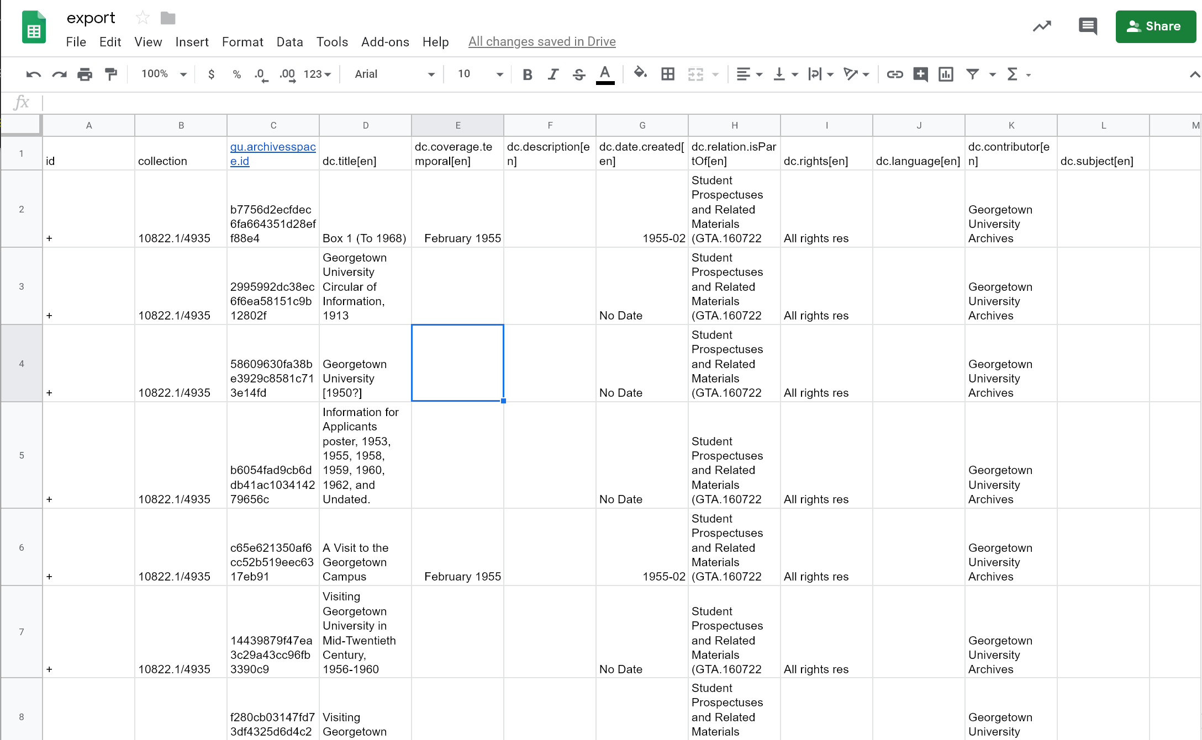
A file name or some other identifier can be added to the spreadsheet to associate metadata with a digital object file.

Slide 10
4. Prepare Ingest Folders for DSpace
Simple Archive Format Ingest Folder
Item Metadata
(CSV)
File Analyzer
DSpace
Digital Files
(bitstreams)
Digital files are associated with metadata and are imported into DSpace

Slide 11
5. View Bitstreams (Digital Objects) in DSpace

Slide 12
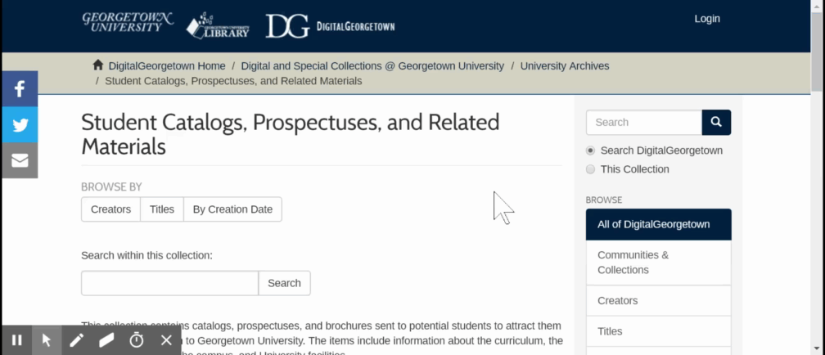

Slide 13
6. Export Item Metadata with Bitstream URL’s using DSpace 6 Report Tools
DSpace Bitstream URL’s will become ArchivesSpace Digital Archival Object (DAO) Links

Slide 14
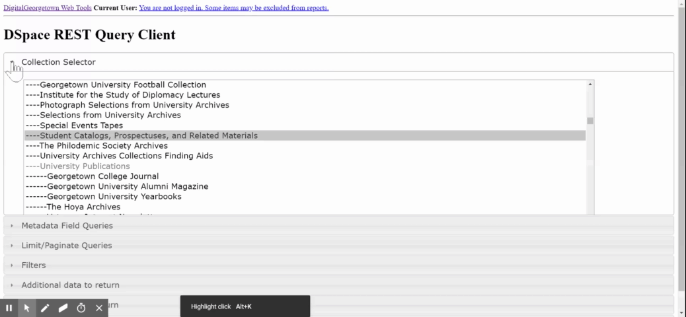

Slide 15
7. Merge report data with EAD file to generate an Excel import file
The merge can be performed on AS refid (if available) or on Title

Slide 16
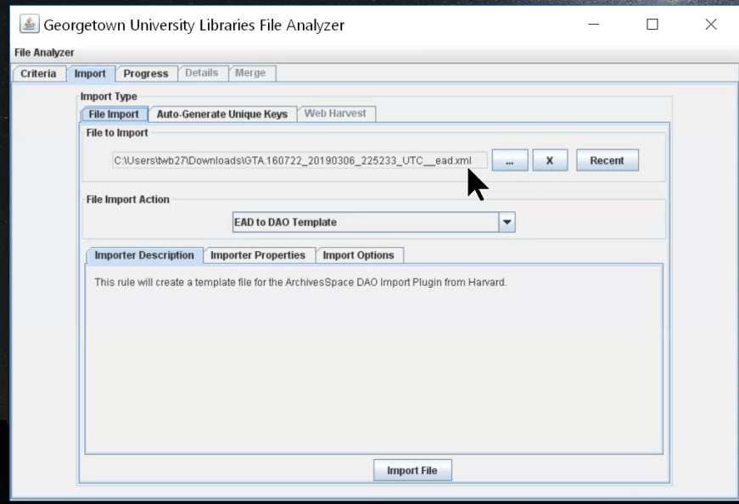

Slide 17
8. Review the generated Excel file
The generated report should be copy and pasted into an Excel template provided by Harvard.

Slide 18
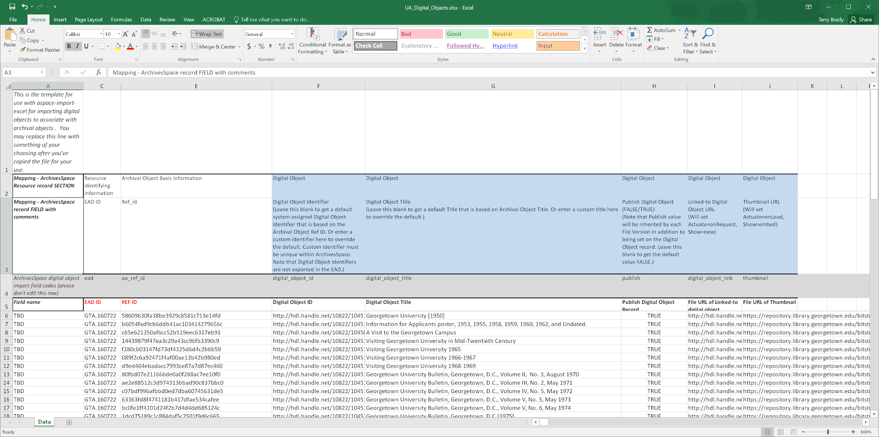
Harvard created this Excel template for use in an ArchivesSpace plugin

Slide 19
9. Import the Excel file with the Harvard Plugin
The contents of the Excel file will become ArchivesSpace DAO (Digital Archival Object) records

Slide 20
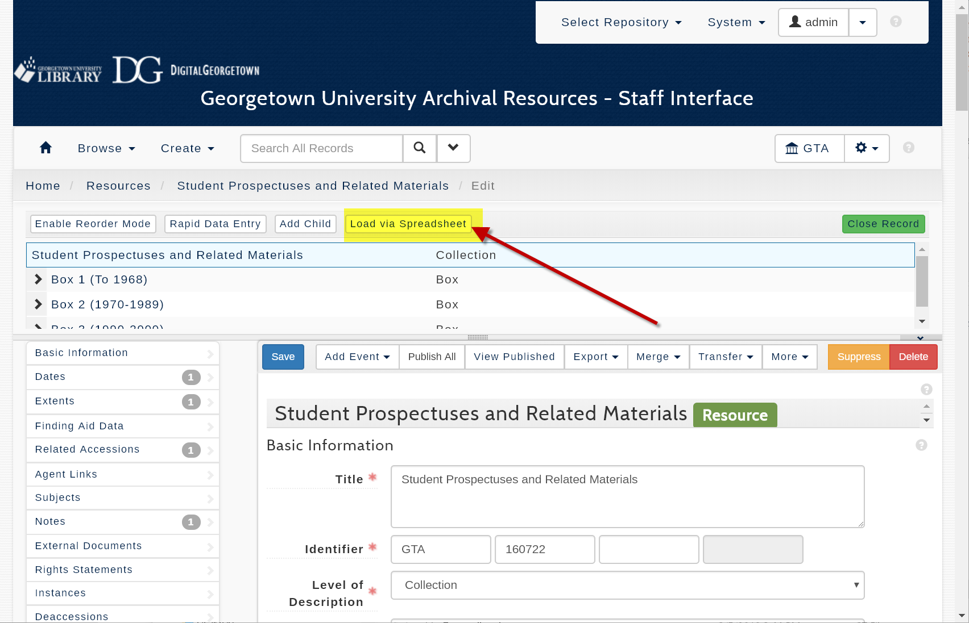

Slide 21
10. View the Digital Objects in the ArchivesSpace PUI

Slide 22
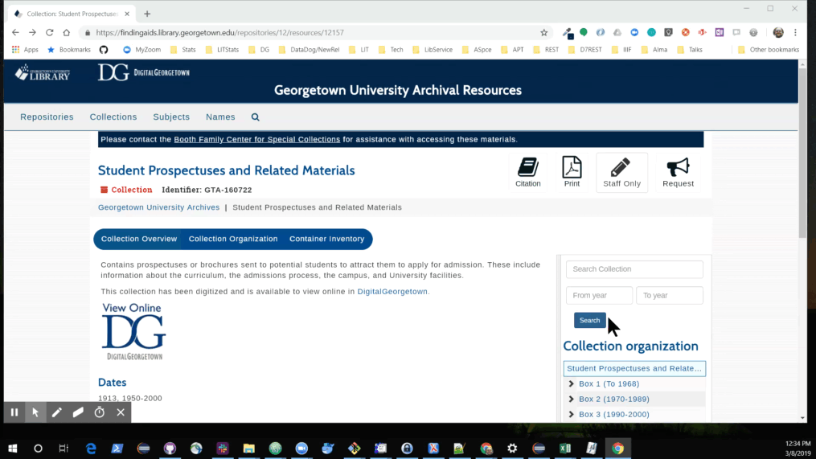

Slide 23
Workflow tools
File Analyzer
  Converts ArchivesSpace EAD XML to Dublin Core
  Prepare Ingest Folders
  Merges DSpace and ArchviesSpace exports to create DAO import spreadsheet
Excel and Google Sheets
  Editing and adding to item-level Dublin Core metadata
DSpace ingest tools
  Batch uploading digital objects and their metadata
DSpace report tools
  Exporting digital object and thumbnail URLs
Harvard’s Excel Import Plugin
  Creating digital object records in ArchivesSpace

Slide 24
More information
View this example archival collection in our ArchivesSpace user interface: https://findingaids.library.georgetown.edu/repositories/12/resources/12157
View this example digital collection in our DSpace repository: https://repository.library.georgetown.edu/handle/10822/1045094
Contact us!
digitalscholarship@georgetown.edu
https://github.com/terrywbrady/info
Documentation and GitHub Links

